Slide 1
DEEP LEARNING · MEDICAL IMAGING
Breast Cancer Classification
Using Convolutional Neural Networks
CBIS-DDSM Dataset · CC & MLO Views · ResNet18 Backbone
3
2
82.6%
CNN Models
Mammogram
Views
Best Val Acc

Slide 2
INTRODUCTION
Breast Cancer & AI-Assisted Diagnosis
Breast cancer is one of the most common cancers worldwide, requiring accurate and early diagnosis.
Key Motivation
Mammography is the primary imaging modality for breast cancer screening.
Early Detection
Saves lives
Reduce Errors
Manual interpretation is time-consuming and subject to inter-observer variability.
AI consistency
Dual Views
Deep learning-based CNN models can learn discriminative features directly from raw images.
CC + MLO richer info
Scalable
This project explores CNN-based classification using CC and MLO mammogram views from CBIS-DDSM.
High throughput screening

Slide 3
PROBLEM STATEMENT
Research Objectives
01
02
Binary Classification
View Comparison
Classify mammogram masses as Benign or Malignant using ResNet18-based CNN.
Compare performance across single-view (CC, MLO) and dual-view models.
03
04
Augmentation Impact
Multi-View Learning
Analyze how data augmentation affects overfitting, bias, and generalization.
Demonstrate that combining CC + MLO views captures richer diagnostic features.

Slide 4
DATASET
CBIS-DDSM Dataset Overview
Dataset
CBIS-DDSM (Curated Breast Imaging Subset)
Patient-Wise Split
Image Type
Mammography (DICOM format)
70%
Training
Classes
Benign / Malignant masses
15%
Validation
Views
CC (Cranio-Caudal) & MLO (Medio-Lateral Oblique)
Split
Train 70% · Validation 15% · Test 15%
15%
Test
Split Strategy
Patient-wise (no data leakage)
⚠ Patient-wise split prevents
data leakage across sets

Slide 5
PREPROCESSING
Data Preprocessing Pipeline
1
2
3
4
5
DICOM → PNG
Tumor Crop
Resize
Normalization
Class Weights
Convert raw DICOM mammogram files to PNG format for CNN compatibility
Use bounding box annotations to crop tumor-focused regions from full mammograms
Resize cropped images to uniform dimensions for model input
Normalize pixel values using ImageNet statistics (mean/std)
Apply class weights (Benign=1.0, Malignant=2.0) to handle class imbalance
🔄 Data Augmentation (when enabled): Random horizontal flip · Random rotation · Color jitter · Random erasing

Slide 6
DATASET
Three Dataset Configurations
CC Only
MLO Only
Dual CC+MLO
Cranio-Caudal (top-down) view
Single-view classification
Medio-Lateral Oblique (angled) view
Single-view classification
Both views combined per patient
Dual-input model
Test Set
Test Set
Test Set
87 test samples
101 test samples
70 test samples
Benign: 40 · Malignant: 47
Benign: 45 · Malignant: 56
Benign: 37 · Malignant: 33
CC Only
MLO Only
CC + MLO

Slide 7
ARCHITECTURE
Model Architecture: ResNet18 Backbone
Input
Image(s)
Conv
Layer 1-2
Layer 3
(frozen)
Layer 4
(trainable)
Global
AvgPool
FC
Classifier
Benign /
Malignant
← Pretrained on ImageNet (frozen early layers)
← Fine-tuned (trainable)
Dual-Input Architecture:
Two independent ResNet18 encoders (one for CC, one for MLO) → feature concatenation → shared FC classifier layer. This allows each view to learn complementary features before joint decision making.
Optimizer
LR
Epochs
Loss
Weights
Adam
1e-4
30
CrossEntropy
B=1.0 M=2.0

Slide 8
TRAINING
Training Configuration
Framework
PyTorch
Augmentation Techniques
Backbone
ResNet18 (ImageNet pretrained)
RandomHorizontalFlip (p=0.5)
Trainable Layers
layer3, layer4, FC classifier
RandomRotation (±15°)
Optimizer
Adam · LR = 1e-4
ColorJitter (brightness, contrast)
Loss Function
CrossEntropyLoss with class weights
RandomErasing (p=0.2)
Epochs
30 · Best model saved by val accuracy
Normalize (ImageNet stats)
Batch Size
16
All models trained with identical hyperparameters — only augmentation and input view configuration differ

Slide 9
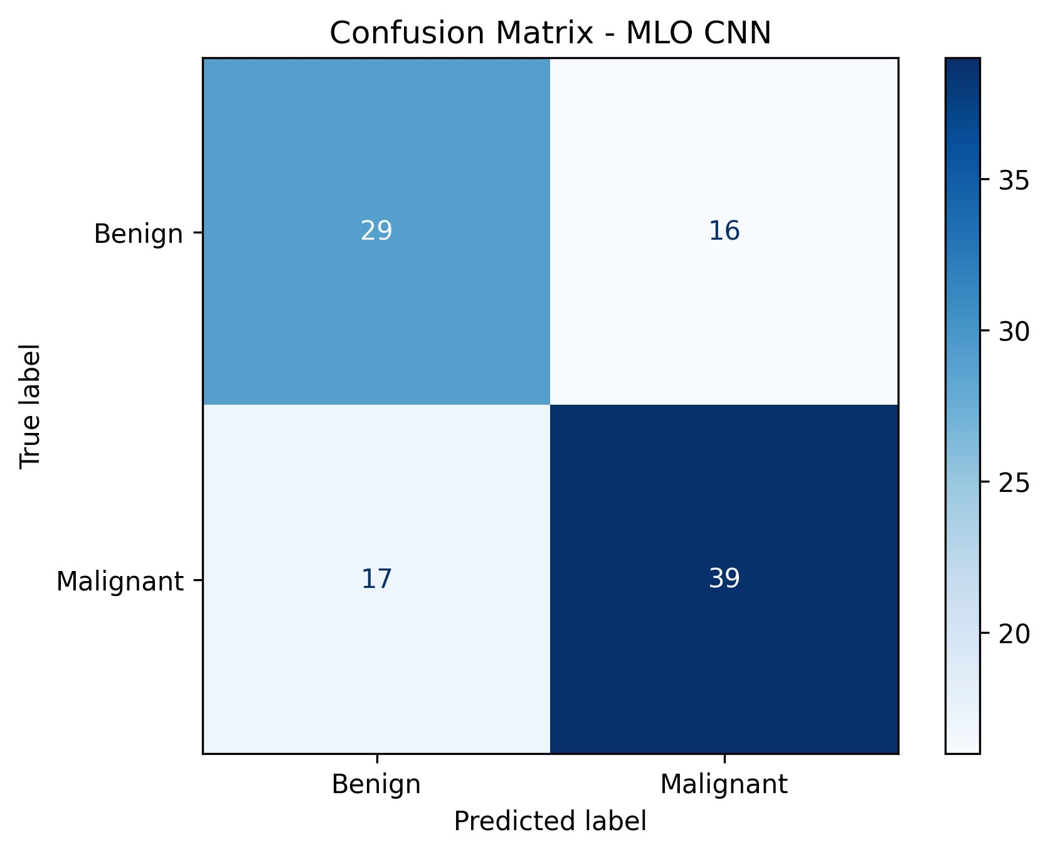
RESULTS
CC View Model Results
73.9%
67.8%
75.9%
Overfitting
Val Accuracy
Test Accuracy
Test Accuracy
Key Issue
No Aug (best)
No Aug · 87 samples
With Aug · 87 samples
Train≈100% Val≈67–73%
No Augmentation
With Augmentation — improved balance
CC No Aug: Strong benign recall (95%) but poor malignant recall (44.7%) — model biased toward benign predictions.

Slide 10
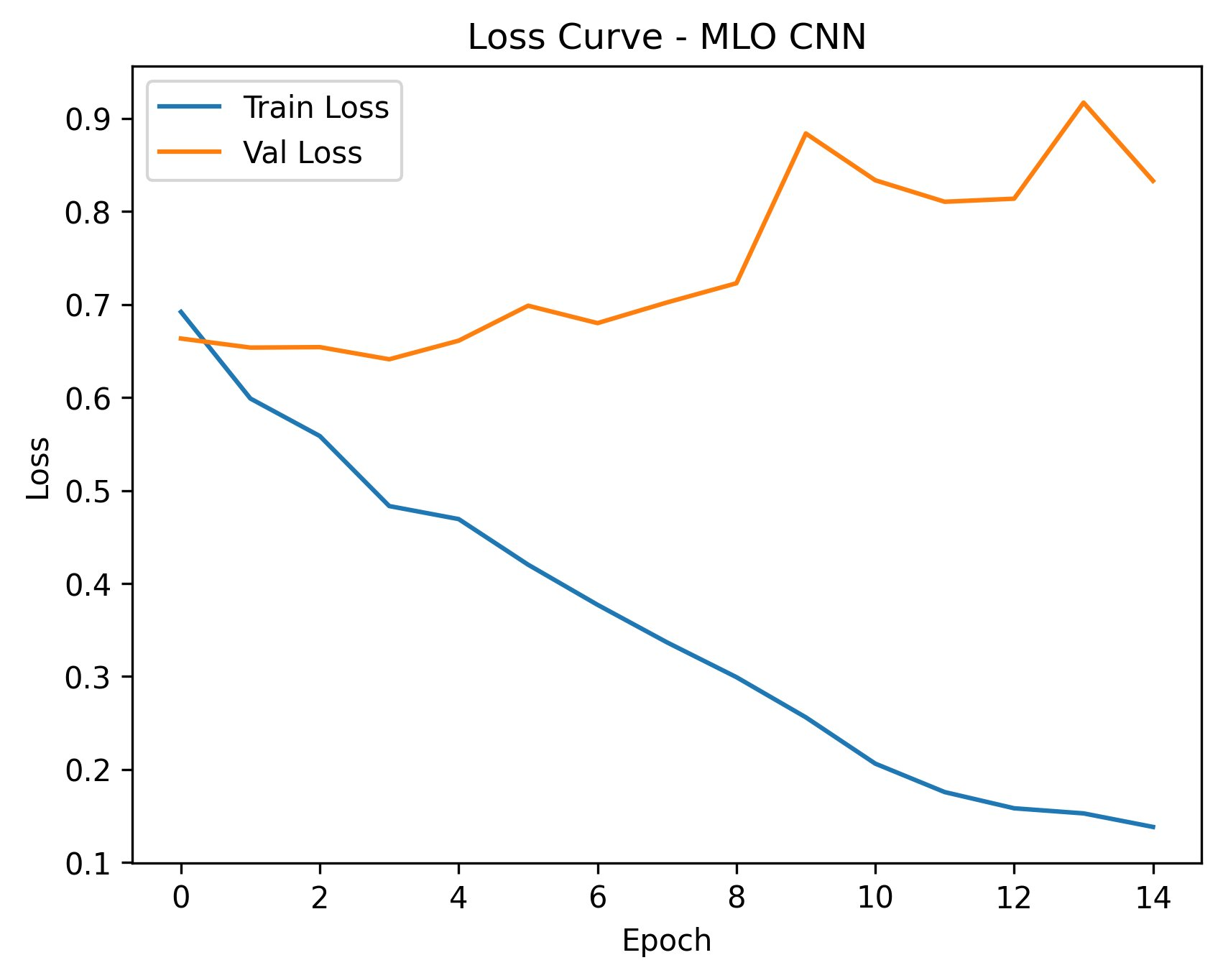
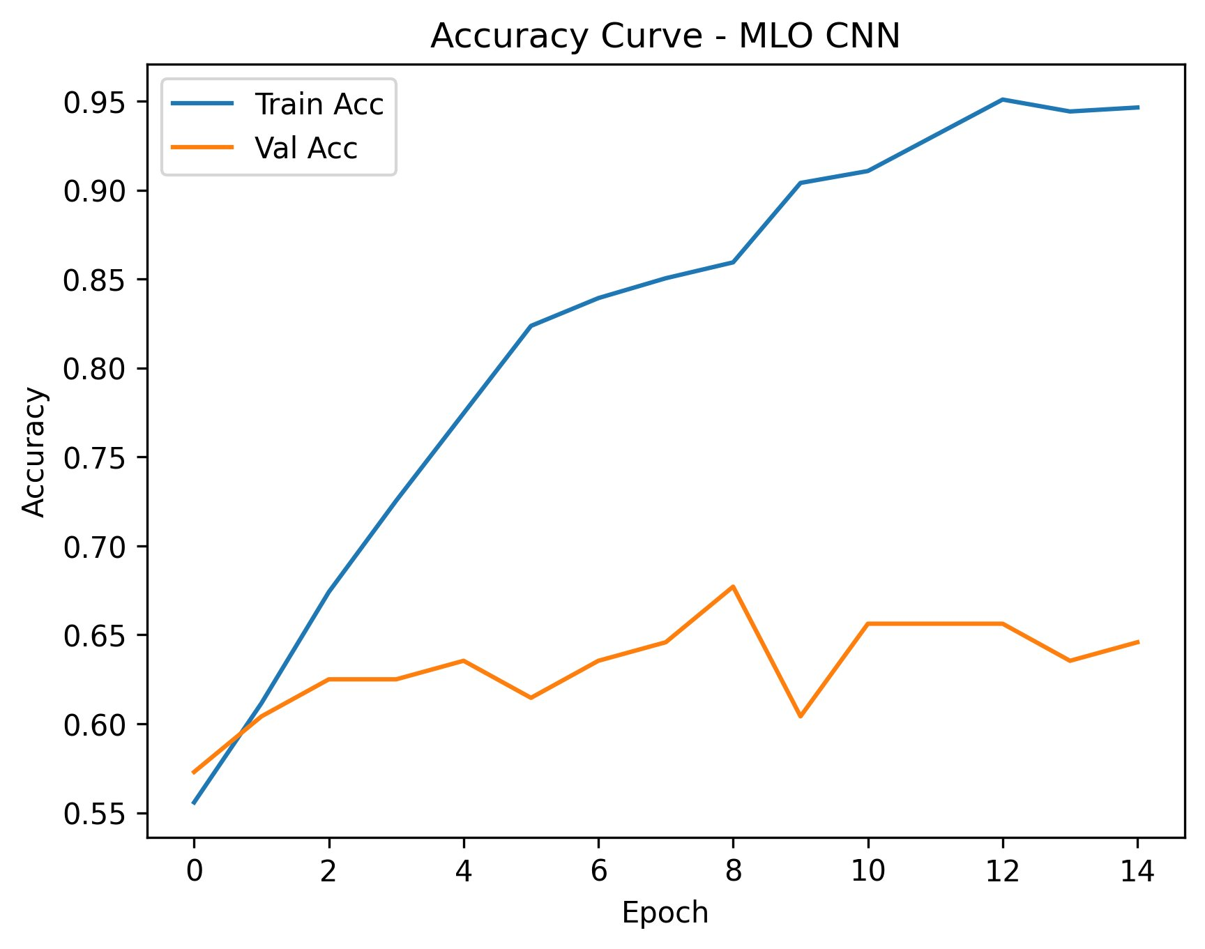
RESULTS
CC Model – Training Curves
⚠ Severe Overfitting Detected: Training accuracy reaches ~99–100% by epoch 4, while validation accuracy plateaus at 67–74% and remains volatile throughout training. The growing gap between train loss (near 0) and validation loss (0.9–1.6) is a clear overfitting signature. Augmentation reduces this gap slightly.

Slide 11
RESULTS
MLO View Model Results
69.8%
67.3%
67.3%
Harder View
Val Accuracy
Test Acc (No Aug)
Test Acc (Aug)
MLO Challenge
No Aug (best)
101 test samples
Balanced recall
Less structured anatomy
MLO No Aug Bias: Strong malignant bias — benign recall only 44.4% vs malignant recall 85.7%. Augmentation corrects this, bringing benign recall up to 64.4% at the same accuracy level (67.3%). MLO view is harder to learn than CC due to less standardized anatomy.

Slide 12
RESULTS
Dual-Input Model Results (Best Performer)
82.6%
74.3%
70.0%
74.3%
Best Val Accuracy
Test Accuracy
Test Accuracy
Perfect F1 Balance
With Augmentation ✓
With Aug · 70 samples
No Aug · 70 samples
Precision = Recall
✓ Best Model: The dual CC+MLO model with augmentation achieves the highest validation accuracy (82.6%) and most balanced class predictions (F1=0.74 for both classes). Combining both views provides richer complementary information than either view alone.

Slide 13
AUGMENTATION ANALYSIS
With vs. Without Augmentation
✗ Without Augmentation
✓ With Augmentation
Train accuracy → ~99–100% (overfitting)
Training more stable and gradual
Validation loss diverges (volatile spikes)
Validation loss better controlled
Strong class bias (malignant or benign)
More balanced class predictions
Poor generalization to test set
Improved generalization (+8% for CC)
Large train/val gap throughout training
Best dual-model val accuracy: 82.6%
Key Conclusion: Augmentation improves model RELIABILITY more than raw accuracy. It reduces overfitting and class bias — critical qualities for clinical deployment where balanced detection matters.

Slide 14
AUGMENTATION ANALYSIS
Training Behavior: Augmentation Impact
Without Augmentation
With Augmentation
Issue Without Augmentation With Augmentation
Overfitting
Train loss → 0, Val loss → 1.0+
Reduced gap, slower divergence
Stability
Volatile val loss spikes
Smoother validation curves
Class Bias
Extreme imbalance in recall
Balanced Benign/Malignant recall

Slide 15
COMPARISON
Model Performance Comparison
Model
Aug
Best Val Acc
Test Acc
Benign Recall
Malignant Recall
F1 Macro
CC CNN
No
73.9%
67.8%
95.0%
44.7%
0.67
CC CNN
Yes
72.8%
75.9%
87.5%
66.0%
0.76
MLO CNN
No
69.8%
67.3%
44.4%
85.7%
0.65
MLO CNN
Yes
67.7%
67.3%
64.4%
69.6%
0.67
Dual CC+MLO
No
81.2%
70.0%
78.4%
60.6%
0.70
Dual CC+MLO
Yes
82.6%
74.3%
70.3%
78.8%
0.74
★ BEST
Dual-input model with augmentation achieves both the highest validation accuracy and the most balanced class-level performance

Slide 16
INSIGHTS
Key Findings & Insights
01
Single-View Insufficient
02
MLO is Harder to Learn
CC and MLO single-view models plateau at ~67–68% accuracy with consistent overfitting, demonstrating that one view alone lacks sufficient discriminative information.
MLO anatomy is less standardized than CC, leading to stronger class bias (toward malignant) and more volatile validation curves, even with identical training setup.
03
Augmentation Reduces Bias
04
Dual-View Wins
Data augmentation reliably reduces class prediction bias and overfitting across all models. The improvement in recall balance is more impactful than raw accuracy gains.
Combining CC + MLO features via dual-input architecture achieves best val accuracy (82.6%) and balanced F1 scores — confirming that multi-view learning captures complementary information.
05
Dataset Size Limits
06
Clinical Relevance
The small test set sizes (70–101 samples) and high variance in validation curves suggest that larger datasets and ensembling would further stabilize performance.
Balanced recall (avoiding bias toward either class) is more clinically important than accuracy alone — a false negative (missed cancer) is far more costly than a false positive.

Slide 17
Conclusion
ResNet18 fine-tuning on mammography is feasible but requires careful regularization strategy to overcome overfitting on small medical datasets.
Dual-input CC+MLO architecture significantly outperforms single-view models — val accuracy improves from ~73% to 82.6%.
Data augmentation is essential for balanced, clinically reliable predictions even when it doesn't drastically improve accuracy.
Patient-wise data splitting is critical to prevent data leakage and ensure valid generalization estimates.
🏆 Best Result: Dual-Input ResNet18 + Augmentation · Val Acc: 82.6% · Test Acc: 74.3% · Balanced F1: 0.74

Slide 18
FUTURE WORK
Future Directions
Larger Datasets
Attention Mechanisms
Cross-View Attention
Incorporate full CBIS-DDSM dataset and external mammography datasets (VinDr, INbreast) to improve generalization and reduce variance.
Add CBAM or channel attention to help the model focus on clinically relevant mass regions and improve interpretability.
Replace simple feature concatenation with cross-attention between CC and MLO features for richer dual-view interaction.
Grad-CAM Visualization
Multi-Task Learning
Clinical Evaluation
Apply gradient-based saliency maps to visualize model decisions and validate alignment with radiologist-annotated regions.
Extend to mass detection + classification jointly — incorporating bounding box supervision alongside class labels.
Prospective study comparing model performance against junior radiologists on unseen cases from clinical sites.

